Slide 1

7023T
Advanced Database Systems
Session 01
Introduction to Data Warehouse
This presentation is based on Michael A. Fudge, Jr.

Slide 2
Course Description
The primary focus of this course is on Data Warehousing and it's applications to business intelligence.

Slide 3
Course Outline
Introduction to Data Warehouse
Data Warehouse Components
Introduction to Kimball Lifecycle
Collecting the Requirements
Introducing the Technical Architecture
Dimensional Modelling 1
Dimensional Modelling 2
Designing the Physical Database and Planning for Performance
Introducing Extract, Transformation, and Load
Designing and Developing the ETL System
Introducing Business Intelligence Applications
Designing and Developing Business Intelligence Applications

Slide 4
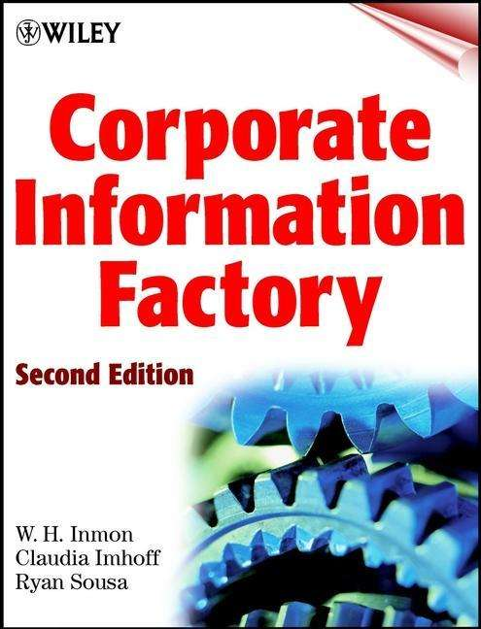
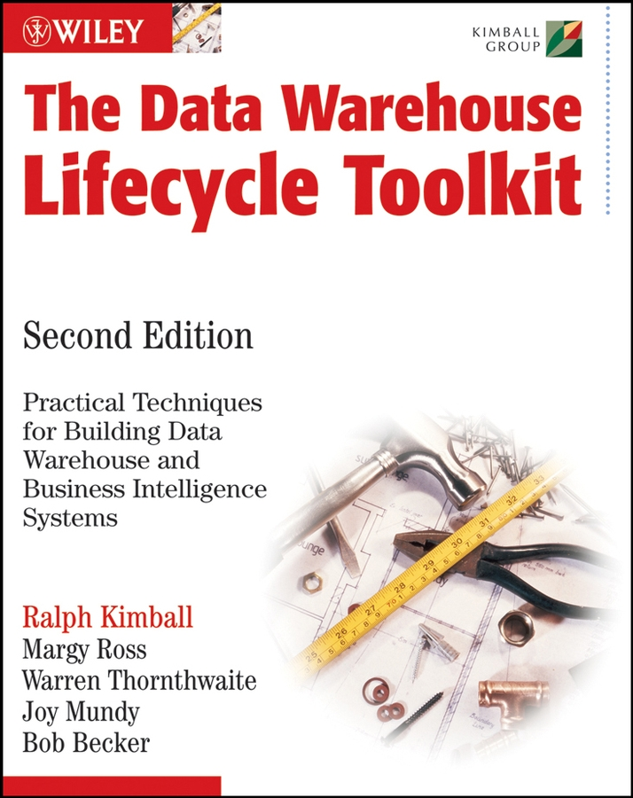
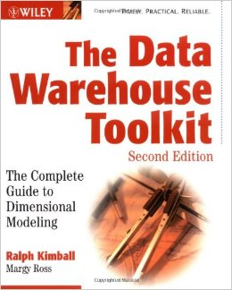
Textbooks
“What”
Inmon
“How To”
Kimball
We’ll use some Inmon definitions, and apply the Kimball Approach.

Slide 5

What is the most important asset of any organization?
Notes:
What do you think it could be? The products it sells? It’s customers? It’s revenue stream?

Slide 6
DATA
Answer:
Why?
Notes:
Think about it this way

Slide 7
Without data:
Do you know your customers?
Understand their needs?
Can you figure out what products to put on sale?
Which ones to discontinue?
Do you know your expenses?
Your Profitability?
Notes:
The answer is a resounding …

Slide 8
NO…
Notes:
Which is why data is so valuable. With it you can’t value other things like customers products, or revenue streams.

Slide 9

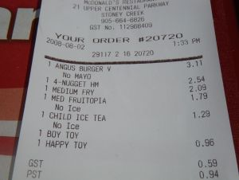
The Informational Needs of an Organization…
Notes:
Imagine we work for a fast-food company. Now imagine you start at the bottom working the register, then move on to fries, then to store manager, then regional manager, and finally all the way to up the executive team.
Think of your informational needs as you work you way up through the organization. Are they the same? Different?

Slide 10
The Informational Needs of an Organization…
Each level of an organization has different informational needs and requirements:
Customers who purchase fries are also likely to buy milkshakes.
How many fries did I sell this week?
Strategic Management
Tactical Management
Operational Management
Do you want fries with that?
Demand for fries in our China locations is up 200%
Non-Management
Organizational Hierarchy
Notes:
We moved up from non management through to strategic management our informational needs changed.

Slide 11
The Technology Behind It All…
Data like this goes into a….
Notes:
When you buy a burger and get a receipt that’s part of a transaction. And the data goes into a

Slide 12
Starts with the Transactional Database
A.k.a. Operational Database
Stored in a Relational Database or files.
Highly Normalized (Data stored as efficiently as possible, lots of tables.)
Optimized for processing speed and handling the “now”.
Designed for capturing data, not for reporting on it.
Designed to support the operational needs of the organization
Notes:
[After slides]
These are great at storing and processing data but not designed to allows us to report on it in ways which meet all the informational needs of the organization.

Slide 13
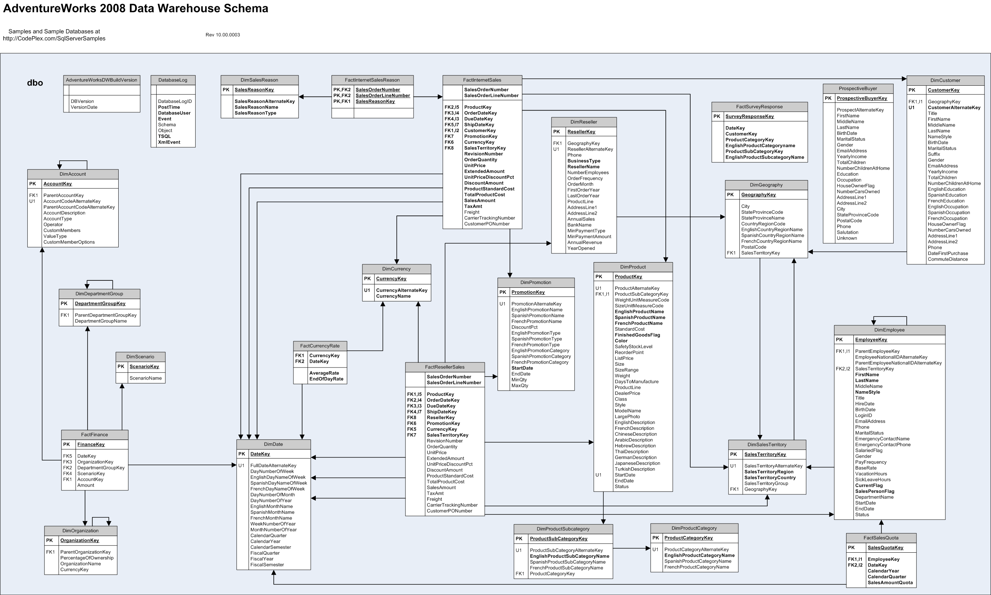
Transactional Databases Are Complex
⬅Adventure works fictitious bicycle manufacturer. 72 tables.
Blackboard Learning Management System. 592 tables.
SU’s Oracle PeopleSoft ERP Implementation 40,000+ tables.
Notes:
Why so complex? They’re designed to minimize data redundancies and store data efficiently. As such they have many tables, generally the more tables the more complex the database.

Slide 14
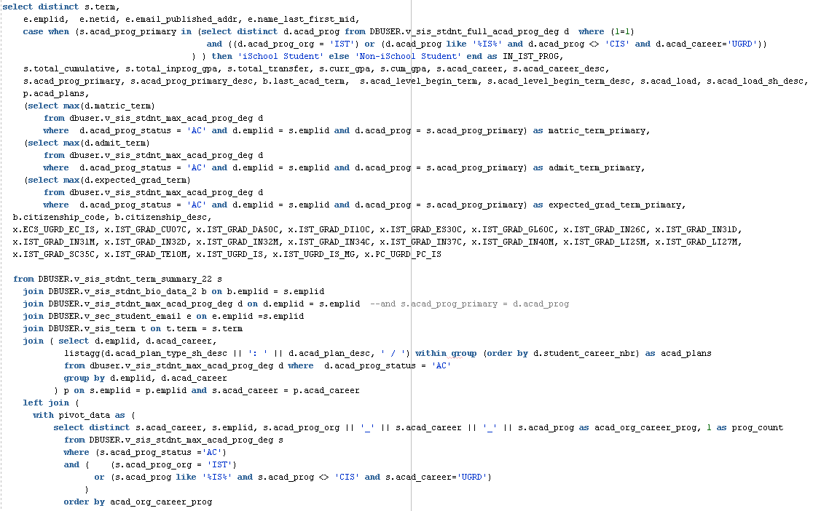
Example: A Query of “iSchool Students”
Students in the current term with gpa, demographics, major, minor, program of study, etc... Either enrolled in one of our programs or taking one of our courses.

Slide 15
Issues Reporting with Transactional Databases
Difficult, Time-consuming & Error prone.
Many joins, sub-selects, Due to vast number of tables.
How do you know your query is correct?
Resource-intensive
The database is not optimized for this purpose.
Multi table joins are RAM and CPU hogs
Impossible
transactional systems are flushed or archived frequently to maintain performance.
You can’t query data you no longer have
Notes:
Resource Intensive
- Optimized writes, not reads.
Impossible
- Some transactional database do not store data in a format conducive to the informational need. They lack trending and historical information.

Slide 16
Solution? The Data Warehouse
Designed to support an organization’s informational needs.
Data is re-structured conducive to reporting and analytic applications.
Transactional databases are data sources for the Data Warehouse.
Data grows over time; existing data in the warehouse very seldom changes.

Slide 17
Characteristics of the Data Warehouse
Time Variant
Flow of data through time
Projected data
Non-Volatile
Data never removed
Always growing
Copy of source data
Integrated
Centralized
Holds data retrieved from entire organization
Subject-Oriented
Optimized to give answers to diverse questions
Used by all functional areas

Slide 18
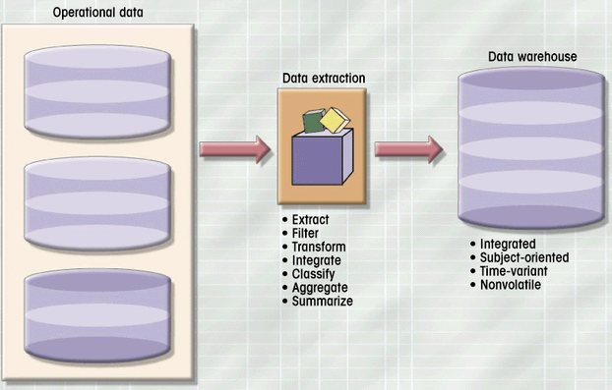
ETL: For Populating the Data Warehouse
Payroll
Sales
Purchasing
Notes:
Explain Diagram

Slide 19
The Data Mart
Single-subject subset of the data warehouse
Provides Decision support to small group
Address local or departmental needs
Notes:
Addressing the informational needs at a small scale is the Data Mart.

Slide 20
The Evolution of the DW
Data Warehouse
Improved Decision Making
Business Intelligence
Notes:
As the data warehouse caught fire it led to improved decision making which in turn led to business intelligence.

Slide 21
Business Intelligence
Analytical and Decision-Support capabilities of the Data warehouse.
The “Glitz and Glam” of Data Warehousing
Notes:
What is BI?

Slide 22
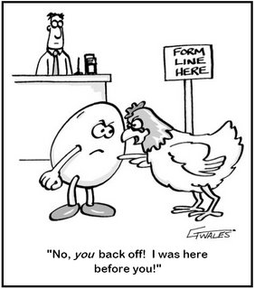
Data Warehouse or Business Intelligence?
Is the data warehouse a component of business intelligence?
or
Is business intelligence a component of the data warehouse?
Notes:
Inmon and Kimball believe they are components to a larger system.
For Inmon they’re part of the CIF.

Slide 23
But how does this work?
Here’s a hyper-abridged example…

Slide 24
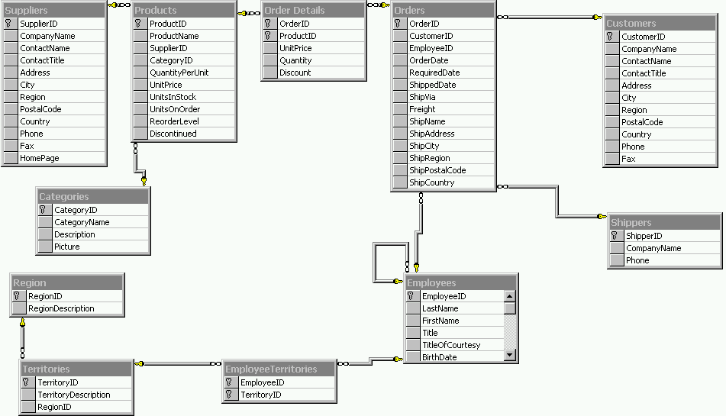
#1: We Have Northwind OLTP Database
Insufficient reporting capabilities
Can only report “In the now”
Complex queries to get questions answered.

Slide 25
#2: Identify business process to model
Business Process & Grain
Orders – products sold to customers over time by sale.
One row per product order (product on the order)
Dimensions
Products, Employees (Sales), Time (Order Date), Customer
Facts
Order Quantity, Order Amount
This represents our Data Mart in the DW

Slide 26
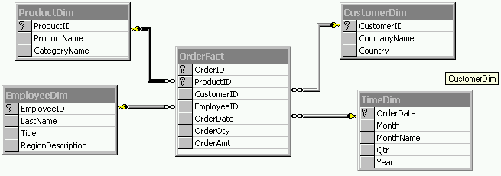
#3: Create Northwind Orders Star Schema
Build the data mart in the Data warehouse
Fact Table + outer Dimensions
Fields are based on what’s available in the source data

Slide 27
#4: Create Northwind Source to Target Map
ProductDim
CustomerDim
How does the OLTP align with OLAP?
Helps us define the ETL process
Fact Table:
OrderFact
EmployeeDim
TimeDim

Slide 28
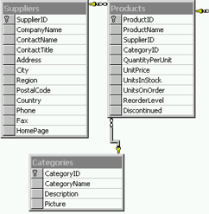

#5: Populate targets with ETL
Products Source
Dimensions before Facts.
Need a strategy to handle changes to data.
Tooling exists to assist with the process.
ProductsDim
Data

Slide 29
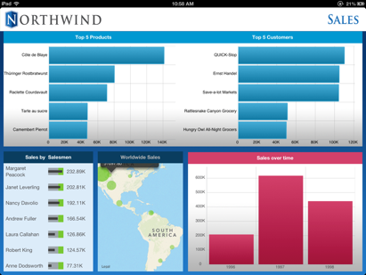
#6: Visualize with a BI Tool
You can easily query star schemas in SQL or better yet use a BI tool like Excel or Tableau
Notes:
Pentaho demo

Slide 30
The Fathers of Data Warehousing
 | W.H. Inmon | Ralph Kimball
The “Father” of… | Data Warehousing | Business Intelligence
Million Dollar Idea: | “Corporate Information Factory” | “Kimball Lifecycle”
“Data Warehouse” Definition | Strict. Subject-oriented summarized data. | Loose. Any query able data.
Approach: How is the Data Warehouse built? | As a whole, over time (Waterfall, Top-down) | In parts, by business process (Iterative, Bottom-up)

Slide 31
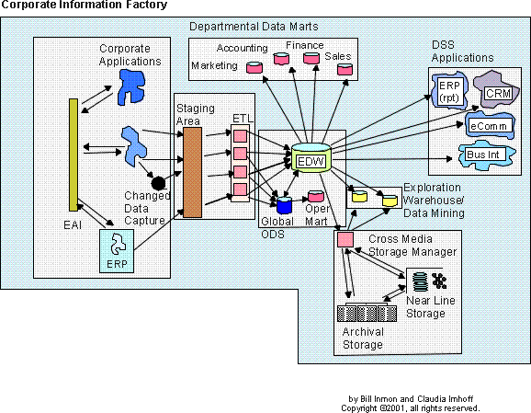
Inmon’s Corporate Information Factory
A reference architecture for an “Information Ecosystem”

Slide 32
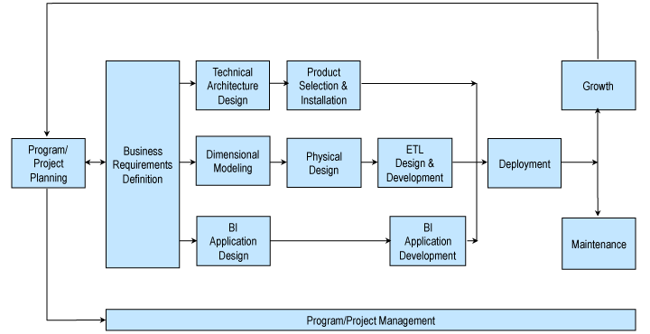
The Kimball Lifecycle
Notes:
Describes an approach for data warehouse projects

Slide 33
The Informational Needs of an Organization, In Summary…
Strategic Management
Decision-Support Data in the
Data Warehouse
Tactical Management
Operational Management
Operational Data in Transactional Databases
Non-Management
Organizational Hierarchy

Slide 34
Relational Philosophies, In Summary…
OLTP
OLAP
Highly normalized
One or more tables per business entity.
Supports the Operational needs of the organization
Lots of tables
Denormlaized
Just Star Schemas
Dimension and Fact tables
Supports the Analytical needs of the organization.
Data mart in the data warehouse

Slide 35
In Summary…
Data is an organizations most important asset.
The transactional systems we use to collect and manage data are not suitable for analysis and reporting.
The data warehouse is a subject-oriented, time-variant, non-volatile collection of operational data.
The data mart supports the decision-support needs of a group or department within the organization.
Business intelligence is the use of information to improve decision making.
Inmon’s Corporate Information factory is a model for business intelligence.
The Kimball Lifecycle is a methodology for creating data warehousing solutions.

